Slide 1
Cycle embedding in star graphs with edge faults
Tseng-Kuei Li
Applied Mathematics and Computation 167 (2005) 891–900
Presenter: Chiao-Wei Chiu
Date: Oct. 17, 2007

Slide 2
Abstract
The star graph is one of the famous interconnection networks. Edge fault tolerance is an important issue for networks, and the cycle embedding problem is widely discussed in many researches. In this paper, we show that the cycles of even lengths from 6 to n! can be embedded into the n-dimensional star graph when the number of edge fault in the graph does not exceed n - 3. Since the graph is bipartite and (n - 1) regular, our result is optimal.

Slide 3
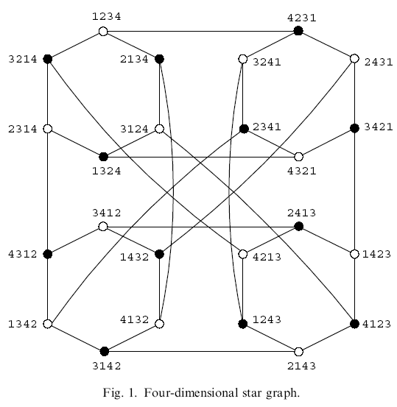
The star graph

Slide 4
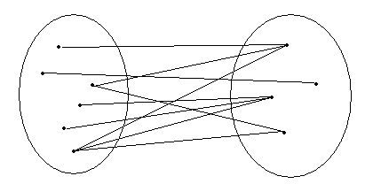
The bipartite graph

Slide 5
The pancyclic problem
Finding cycles of lengths from 3 to the number of vertices in the graph.
Since the star graphs are bipartite graphs, they contain no odd length cycles.
Moreover, the minimum length of cycles of the star graphs is 6.
Jwo et al. [10] showed that an n-dimensional star graph contains cycles of even length from 6 to n! Thus, we say that the star graphs are weak-bipancyclic.

Slide 6
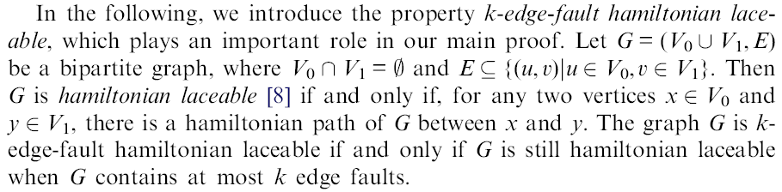
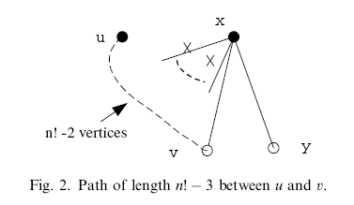
Hamiltonian laceable

Slide 7
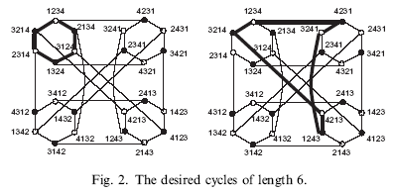
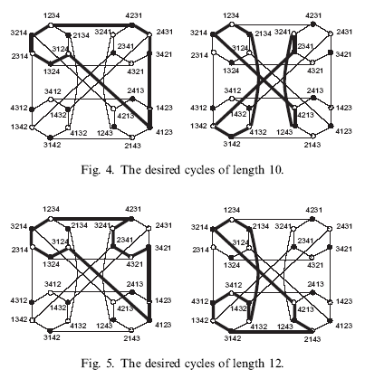
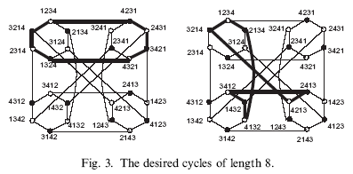

Slide 8
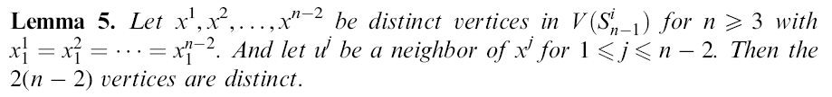
e.g. 1234 – 2134 – 3124 - 1324
x – x, contradiction
x – u – x, contradiction

Slide 9
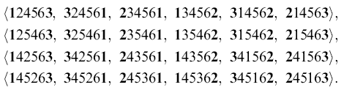
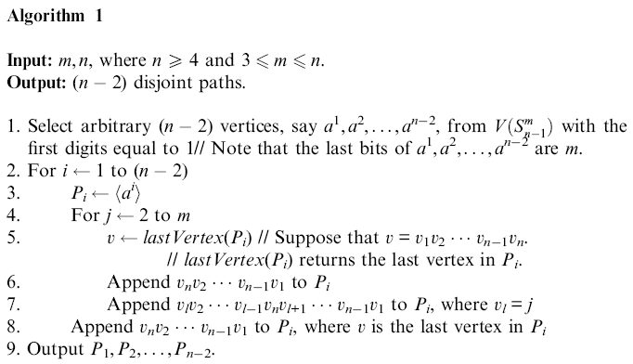
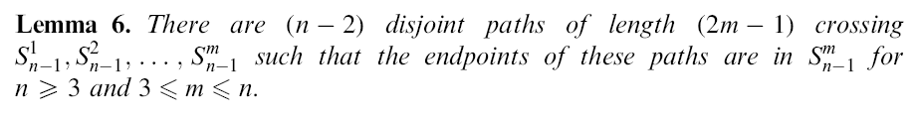
n = 6, m = 3

Slide 10
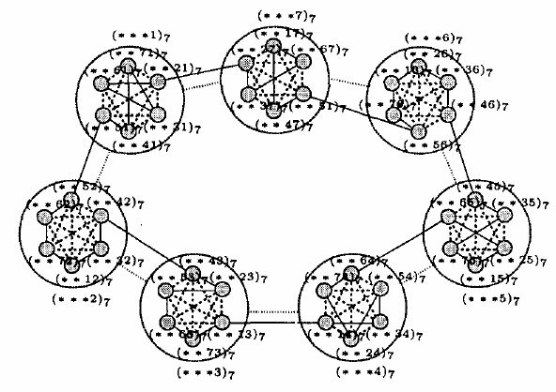
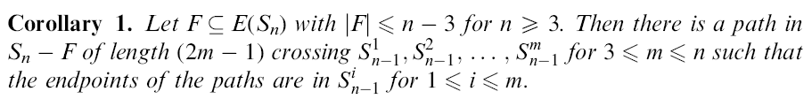

Slide 11
